Slide 1
Using tf-idf and svd for movie recommendation
Robert Trout
LING 165
05/07/2018

Slide 2
Goal
Use tf-idf and SVD methods to perform comparison of movies

Slide 3
steps
Scape data off the web
Process data
Construct tf-idf matrix
Create queries, apply same transformation
Apply cosine similarity to resulting vectors
Use Truncated SVD, same process as above
Use LDA, same process as above
Compare results

Slide 4
Methodological choices
American films
Easier for me to process and verify results
Easy database to gather from (English Wikipedia)
Plot only
Easier to collect data
Features are all the same
Easier to compare methods with limited input

Slide 5
Scraper
Source:
Wikipedia
Steps:
Go through American Films site: https://en.wikipedia.org/wiki/Lists_of_American_films
Create list of all movies under each decade
Use python package ‘Wikipedia’ to gather plots for each page.

Slide 6
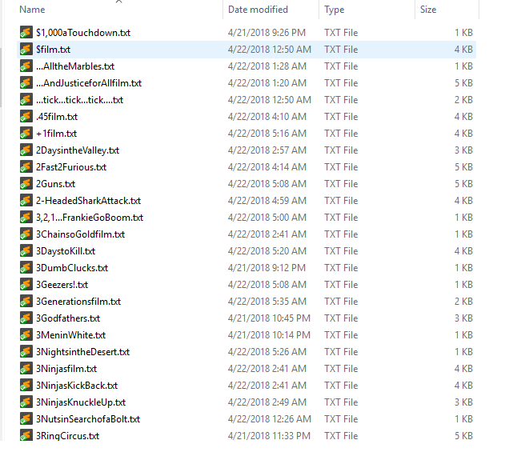
Scraper cont’d

Slide 7
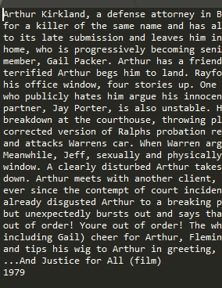
Scraper cont’d

Slide 8

Scraper cont’d

Slide 9
TF-idf
Sklearn
from sklearn.decomposition import TruncatedSVD
from sklearn.decomposition import LatentDirichletAllocation
import numpy as np
import pandas as pd
import nltk, re, os, pickle, scipy, warnings, sys

Slide 10
Tf-idf/SVD steps
Designate plot folder/test folder
Make sure formats are correct
Stem/Lemmatize
Tf-idf vectorizer
Plots matrix
Queries
Truncated SVD decomp
Tf-idf matrix
Queries
LDA decomp
Tf-idf matrix
Queries
Cosine similarities

Slide 11
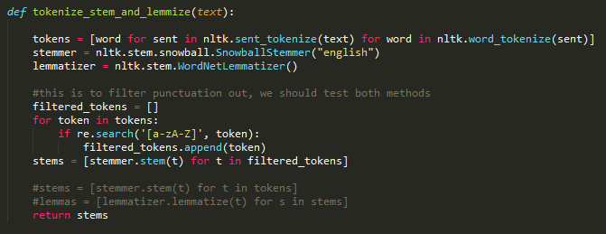
Tokenize and Stem (lemmas skipped)

Slide 12

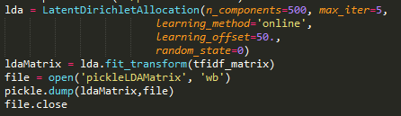
Vectorizers

Slide 13
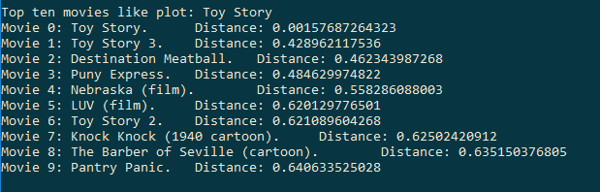
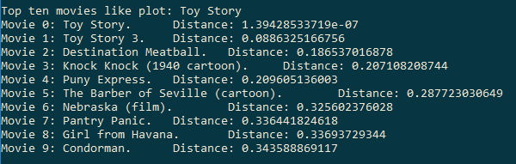
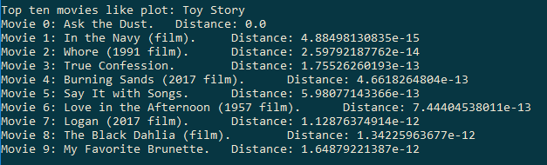
Results
TF_IDF
Toy Story
SVD
LDA

Slide 14
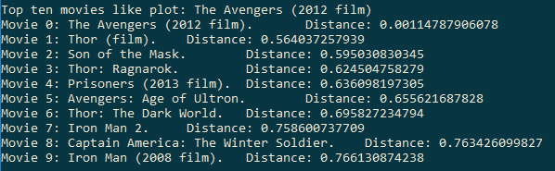
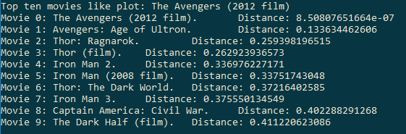
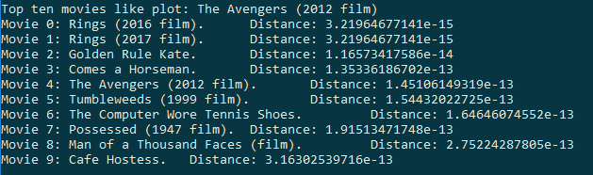
Results
TF_IDF
Avengers
SVD
LDA

Slide 15
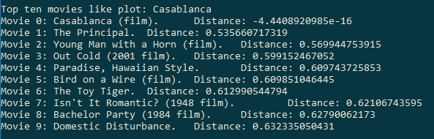
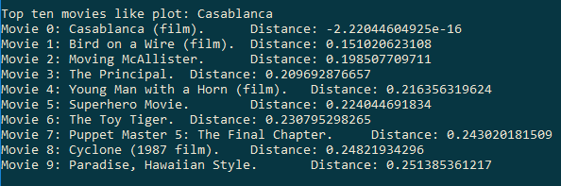
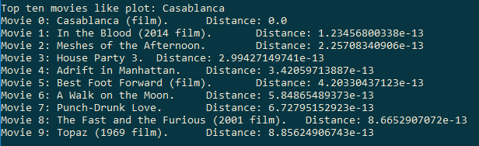
Results
TF_IDF
Casablanca
SVD
LDA

Slide 16
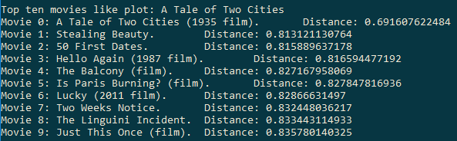
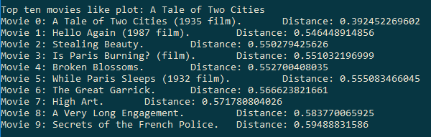
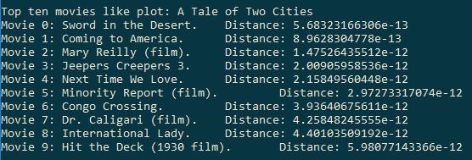
Results
TF_IDF
Tale of Two Cities
SVD
LDA

Slide 17
demonstration

Slide 18
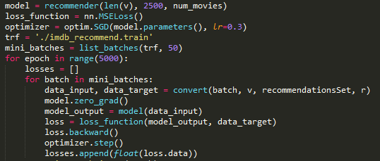
Work in progress
Neural net
Used IMDB as source
It’s own scrapper
Forward fed
Vocab as input
Movie titles as output

Slide 19
Future work
Using different hyperparameters for tf-idf (which min-df and max-df?)
Use broader film base, non-American films
Integrate other features (i.e. Actors, Year, etc.)
Better stop words (Alice, as example)
Have interface to directly enter movie title
Do comparisons of TV show episodes to see similar types of episodes
Classification with various methods (k-means, etc.)
Predict/classify genres
Use smart hyperparameters for neural net
Get a better computer for neural net

Slide 20
Questions?

